Slide 1

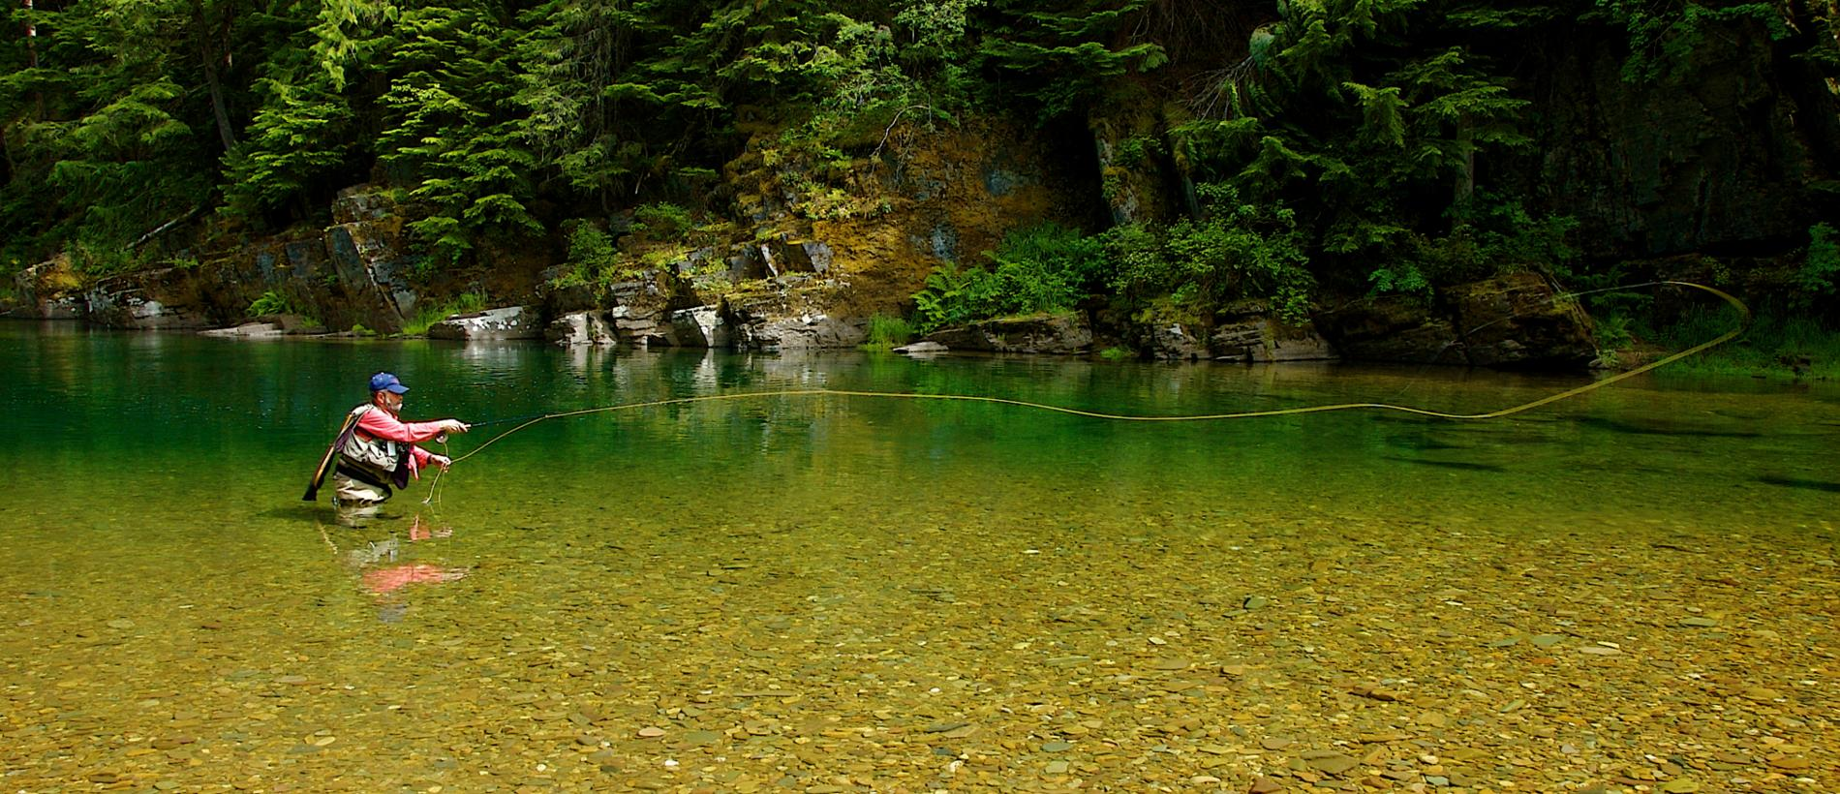
Photo used with permission of ROW Adventure Center
Coeur d’Alene Lake Level Claim
October 28, 2015

Slide 2
Lake Coeur d’ Alene 95-2067
I.C. § 67-4304
Enacted in 1927
Directed Governor to:
“[A]ppropriate in trust for the people of the state of Idaho all the unappropriated water of . . . Coeur d’ Alene Lake[] or so much thereof as may be necessary to preserve said lakes in their present condition.”
Governor holds the right “in trust for the people of the state.

Slide 3
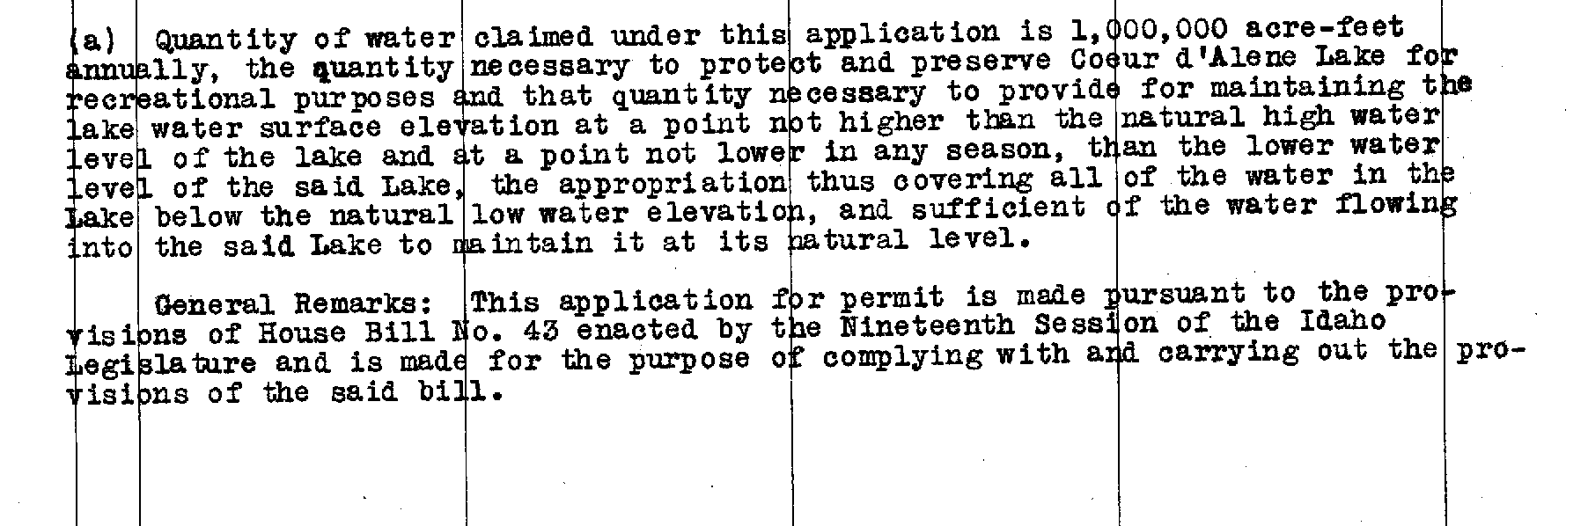
Lake Coeur d’ Alene 95-2067
Application for Permit claimed quantity to maintain elevation at “the natural high water level of the lake and at a point not lower in any season, then the lower water level of the said lake.”
And “sufficient water flowing into Lake to maintain it at its natural level”

Slide 4
Affidavit of Proof of Beneficial Use
What is the minimum amount of water required for the purpose specified above?
“All the waters of Coeur d’Alene Lake and its tributaries which remained unappropriated at the date of priority claimed for this permit, to-wit: the 27th day of January, 1927, to the extent of 1,000,000 acre-feet annually.”

Slide 5

Lake Coeur d’ Alene 95-2067
Water Right License
Priority Date: January 24, 1927
1,000,000 ACRE FEET ANNUALLY
“Amount necessary to maintain the level of Coeur d’ Alene Lake not higher than normal high water stage and not lower than the natural low water stage.”

Slide 6
CONCLUSION

